Slide 1
COMP28112 Lecture 13
Distributed Transactions
COMP28112 Lecture 13

Slide 2
Transactions (recap from last time)
A set of operations that is either fully committed or aborted as a whole (i.e., the set is treated as an atomic operation); if aborted, no operation in the set is executed:
  This guarantees that data will not be left in a corrupted state as a result of (unforeseen) server crashes or other concurrent transactions (cf. client-server example with bank transfer from last lecture).
Need to provide:
  Concurrency control
  Recovery mechanisms
COMP28112 Lecture 13

Slide 3

Concurrency Control
Hmm, if only I was able to lock available hotel and band slots in lab exercise 2… it would make my life easier!
Two-phase locking
  “Acquire locks” phase
    Get a read lock before reading
    Get a write lock before writing
    Read locks conflict with write locks
    Write locks conflict with read and write locks
  “Release locks” phase when the transaction terminates (commit or abort)
What does all this remind you of? (☺ recall COMP25111, thread synchronization: there are some key problems in core Computer Science!)
COMP28112 Lecture 13

Slide 4
Using locks…
…concurrent transactions are serialised.
Now, think about part 3 of lab exercise 2. Assume that the server allowed you to submit (locked) transactions:
Begin transaction
get hotel_free_slots;
get band_free_slots;
slot=find_earliest_common_slot;
book_hotel(slot);
book_band(slot);
End transaction
What would the problem be?
COMP28112 Lecture 13

Slide 5
Disadvantages of locks
Reduce significantly the potential for concurrency even though they are really needed in extreme cases.
May result in a deadlock!
Improvements:
  Optimistic concurrency control: transactions are allowed to proceed as normal and everything is checked at the ‘commit transaction’ phase. If there is a problem, transactions are then aborted.
  Timestamp ordering: each operation in a transaction is validated when it is carried out. If it cannot be validated, the transaction is aborted immediately.
COMP28112 Lecture 13

Slide 6
Recovery
When a transaction needs to be aborted:
Backward recovery: bring the system from its present (erroneous) state into a previously correct state. To do so, the system’s state from time to time is recorded; each time this happens, a checkpoint is said to be made.
Forward recovery: try to bring the system to a correct new state from which it can continue to execute. It must know in advance which errors may occur (so that it is possible to correct them!)
COMP28112 Lecture 13

Slide 7
Recall our Simple Application Example
(a client communicating with a remote server)
Transfer £100 from account 1 to account 2
  x = read_balance(1);
  y = read_balance(2);
  write_balance(1, x - 100);
  write_balance(2, y + 100);
COMP28112 Lecture 13

Slide 8
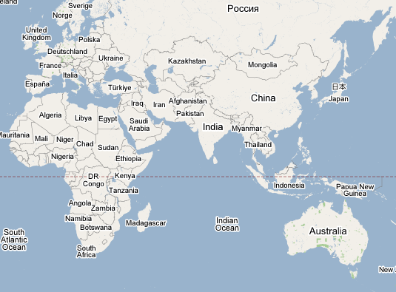

What if the accounts are held in two databases?
COMP28112 Lecture 13

Slide 9

Transfer Funds Across Databases
Transfer £100 from Acct 1 to Acct 2
Acct | Bal
1 | 200
Acct | Bal
2 | 400
COMP28112 Lecture 13

Slide 10
The Joys of Distributed Computing
More problems to worry about:
  One or both databases can fail at anytime or be slow to respond
  Slow or faulty network
  How does your distributed application handle these failures?
COMP28112 Lecture 13

Slide 11
Distributed transactions to the rescue
(transactions where more than one server is involved)
?
COMP28112 Lecture 13

Slide 12
Distributed Transactions
begin_transaction
x = read_balance(1);
y = read_balance(2);
write_balance(1, x - 100);
write_balance(2, y + 100);
commit;
Transaction
Monitor
CRASH
CRASH
CRASH
CRASH
CRASH
COMP28112 Lecture 13
Notes:
Note: all non-committed transactions are aborted after a crash!

Slide 13
All-or-Nothing
ALWAYS
  either
  ALL databases commit the transaction
  or
  ALL databases abort the transaction
Example of a consensus problem
  Everyone MUST agree on a single outcome
More generally:
  The distributed commit problem: an operation is performed by each member of a process group or none at all.
COMP28112 Lecture 13

Slide 14
What protocol do we need to support distributed transactions?
(protocol = standard rules regarding the messages exchanged between the servers)
Step 1: A coordinator is chosen (figure 14.3 in CDK)
openTransaction
join
participant
closeTransaction
.
A
a.withdraw(4);
.
join
BranchX
T
participant
b.withdraw(T, 3);
Client
B
b.withdraw(3);
T =
openTransaction
BranchY
a.withdraw(4);
join
c.deposit(4);
participant
b.withdraw(3);
d.deposit(3);
C
c.deposit(4);
closeTransaction
D
d.deposit(3);
Note: the coordinator is in one of the servers, e.g. BranchX
BranchZ

Slide 15
One-phase atomic commit
Client tells the coordinator to commit or abort a transaction
The coordinator communicates the commit (or abort) to all participants.
(obvious) problem: if one of the participants cannot actually perform the operation it cannot tell the coordinator.
COMP28112 Lecture 13

Slide 16
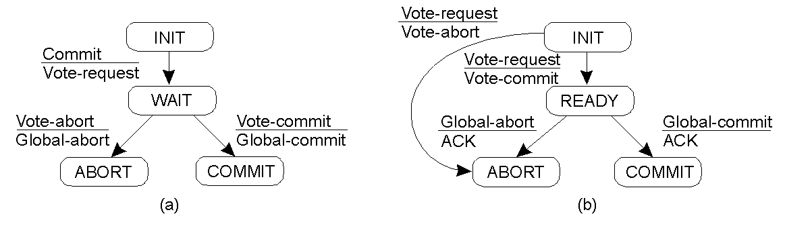
Two-Phase Commit (see Fig. 14.6 in CDK and Fig.8.18 in TvS)
Coordinator
Participant
step
status
step
status
prepared to commit
canCommit?
1
(waiting for votes)
Yes
2
prepared to commit
3
committed
doCommit
(uncertain)
haveCommitted
4
committed
done
coordinator
participant
COMP28112 Lecture 13

Slide 17
Drawbacks of Two-Phase-Commit
What if the coordinator has failed?
  Three-phase commit protocol
  Multicast to all other participants
Participants need to trust the coordinator
Transactions should be short in duration
Distributed deadlocks may occur!
COMP28112 Lecture 13

Slide 18
Conclusion
A distributed transaction is a transaction whose activity involves several different servers.
Nested transactions may be used for additional concurrency.
Atomicity requires that all servers participating in a transaction either all commit it or all abort it.
Reading: Coulouris4, Chapter 14; Coulouris5, Chapter 17; Tanenbaum, Sections 8.4-8.6 (too detailed in parts and not transaction-focused)
COMP28112 Lecture 13

Slide 19
Some additional information on deadlocks
COMP28112 Lecture 13

Slide 20
Deadlocks
If we use locking to implement concurrency control in transactions, we can get deadlocks (even within a single server)
So we need to discuss:
  Deadlock detection within a single system
  Distributed deadlock
COMP28112 Lecture 13

Slide 21
Deadlock detection
A deadlock occurs when there is a cycle in the wait-for graph of transactions for locks
There may be more than one
Resolve the deadlock by aborting one of the transactions ….
E.g. the youngest, or the one involved in more than one cycle, or can even use “priority” ….
COMP28112 Lecture 13

Slide 22
CDK Figure 13.20
A cycle in a wait-for graph
Held by
Waits for
A
T
U
T
U
B
Waits for
Held by
COMP28112 Lecture 13

Slide 23
Distributed Deadlock
Within a single server, allocating and releasing locks can be done so as to maintain a wait-for graph which can be periodically checked.
With distributed transactions locks are held in different servers – and the loop in the entire wait-for graph will not be apparent to any one server
COMP28112 Lecture 13

Slide 24
Distributed deadlock (2)
1 solution is to have a coordinator to which each server forwards its wait-for graph
But centralised coordination is not ideal in a distributed system
Have problems of phantom deadlocks
COMP28112 Lecture 13

Slide 25
CDK Figure 14.14
Distributed deadlock
(a)
(b)
W
W
Held by
Waits for
C
D
A
Z
X
V
Held
Waits
Held by
by
for
U
V
U
B
Waits for
Held
by
Y

Slide 26
Phantom deadlocks
Information gathered at central coordinator is likely to be out-of-date
So a transaction may have released a lock (by aborting) but the global wait-for graph shows it as still holding it!
Thus a deadlock might be detected which never existed!
COMP28112 Lecture 13

Slide 27
An Alternative: Edge Chasing
An alternative to a centralised deadlock checker is “Edge Chasing” or “Path Pushing”.
Send a message (probe) containing “T->U” to the server at which U is blocked
This message gets forwarded (and added to) if the lock U is waiting for is held by V …
If a transaction repeats in the message, the deadlock is detected …
E.g, T -> U -> V -> W -> X -> T
COMP28112 Lecture 13

